Slide 1
NETW211
CLOUD AND COMPUTING

Slide 2
Cloud computing has been around for approximately two decades and despite the data pointing to the business efficiencies, cost-benefits, and competitive advantages it holds, a large portion of the business community continues to operate without it.
Cloud and Computing

Slide 3
NETW211 Course Project Module 2 Virtual Machine (VM) Instances

Slide 4
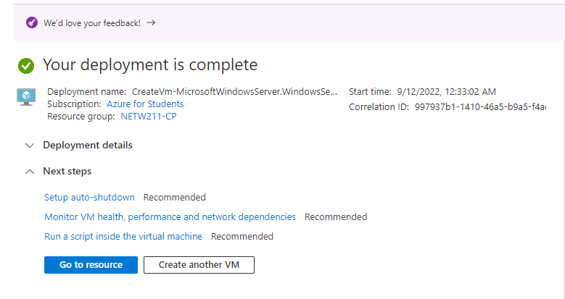
Deploying a VM in Azure
This screenshot should show the NETW211VM page with information such as the resource group name, subscription, public IP address, etc.

Slide 5
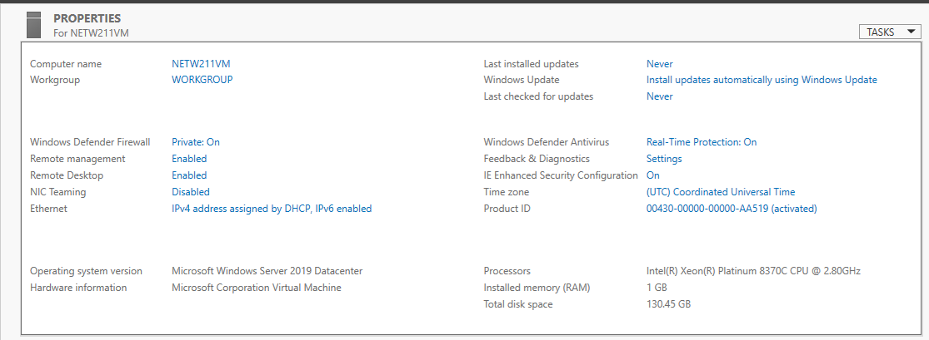
Connecting to the VM
This screenshot should show the PROPERTIES for NETW211VM page, with the computer name, operating system version, hardware information, etc.

Slide 6
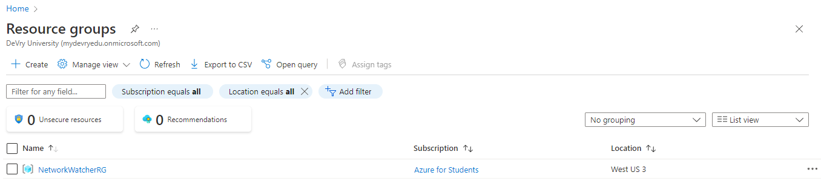
Deleting
the VM
This screenshot should show the Resource groups page, with the Azure for Students subscription selection and the “No resource groups to display” message.

Slide 7
NETW211 Course Project Module 3 Azure VNet and Subnets

Slide 8
Creating a VNet with Two Subnets
1. With a /24 network prefix, how many usable IPv4 host addresses are there? [hint: you learned this in NETW191]
Answer here:
There are 246 IPv4 host addresses
2. Given the answer above, why is the number of available IP addresses for Subnet0 (10.0.0.0/24) or Subnet1 (10.0.1.0/24) shown as 251? [hint: where did the missing addresses go?]
Answer here:
Subnet we will have 251 available since 5 Ip address are in azure
References (here are two examples to get your research started):
1. IP Subnet Calculator, https://www.calculator.net/ip-subnet-calculator.html
2. Azure Virtual Network frequently asked questions, https://docs.microsoft.com/en-us/azure/virtual-network/virtual-networks-faq
3.asmed.com
4. Youtube videos

Slide 9
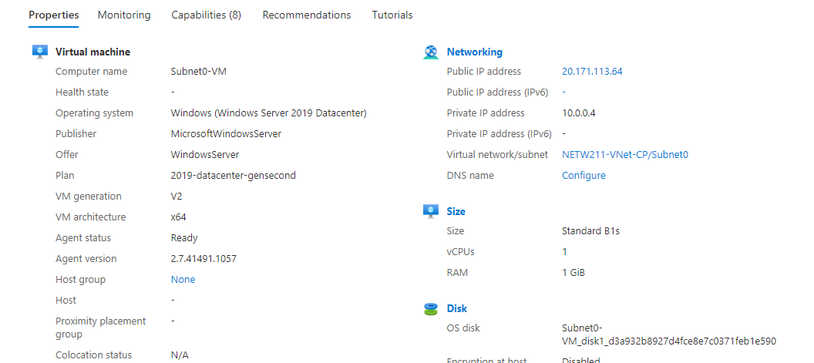
Deploying VMs into Subnets
This screenshot should show the Properties section of the Subnet0-VM page, showing the networking and size information of the VM.

Slide 10
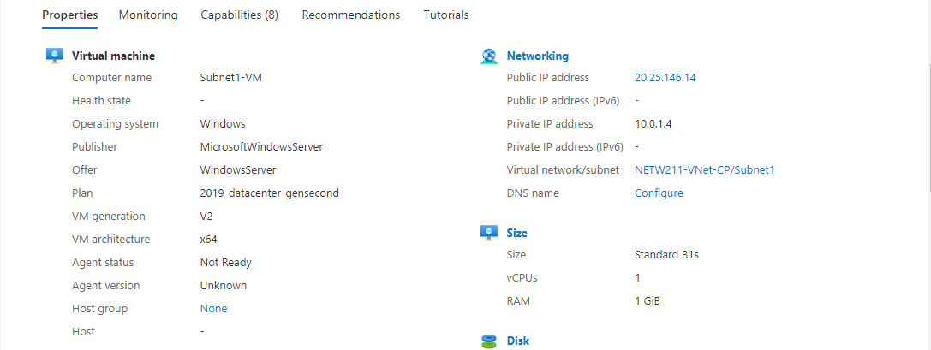
Deploying VMs into Subnets cont’d
This screenshot should show the Properties section of the Subnet1-VM page, showing the networking and size information of the VM.

Slide 11
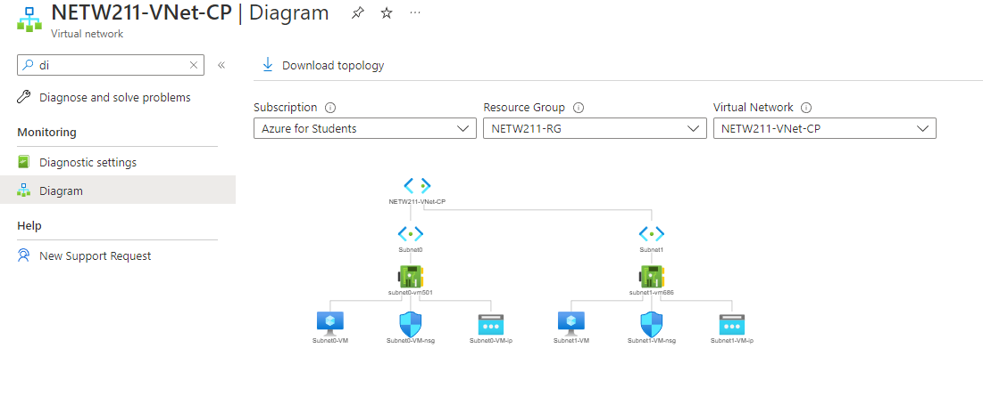
Deploying VMs into Subnets cont’d
This screenshot should show the topology diagram of your VNet (NETW211-VNet-Your Initials) with two subnets (Subnet0 and Subnet1) and one VM in each subnet (Subnet0-VM and Subnet1-VM).

Slide 12
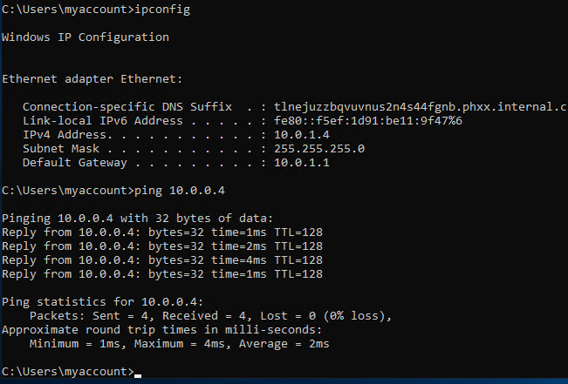
Verifying Connectivity between VMs
This screenshot should show the ipconfig and ping x.x.x.x results in the command prompt window, including the Subnet0-VM – x.x.x.x – Romote Desktop Connection window title.

Slide 13
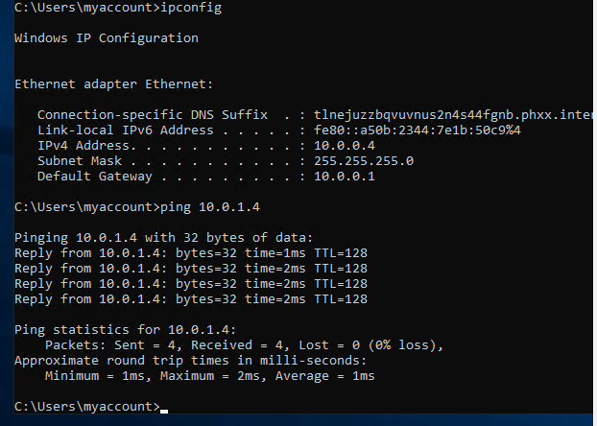
Verifying Connectivity between VMs
cont’d
This screenshot should show the ipconfig and ping x.x.x.x results in the command prompt window, including the Subnet1-VM – x.x.x.x – Romote Desktop Connection window title.

Slide 14
NETW211 Course Project Module 4 Azure VM Security

Slide 15
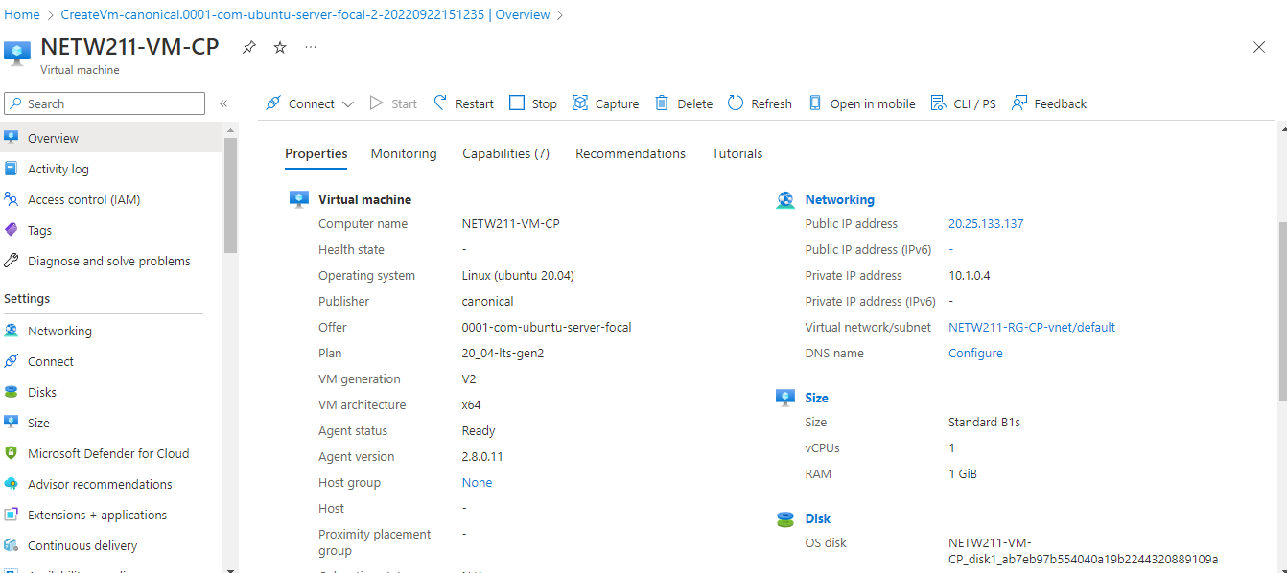
Launching a VM
This screenshot should show the NETW211-VM-Your Initials page, with information such as the resource group name, subscription, public IP address, etc.

Slide 16
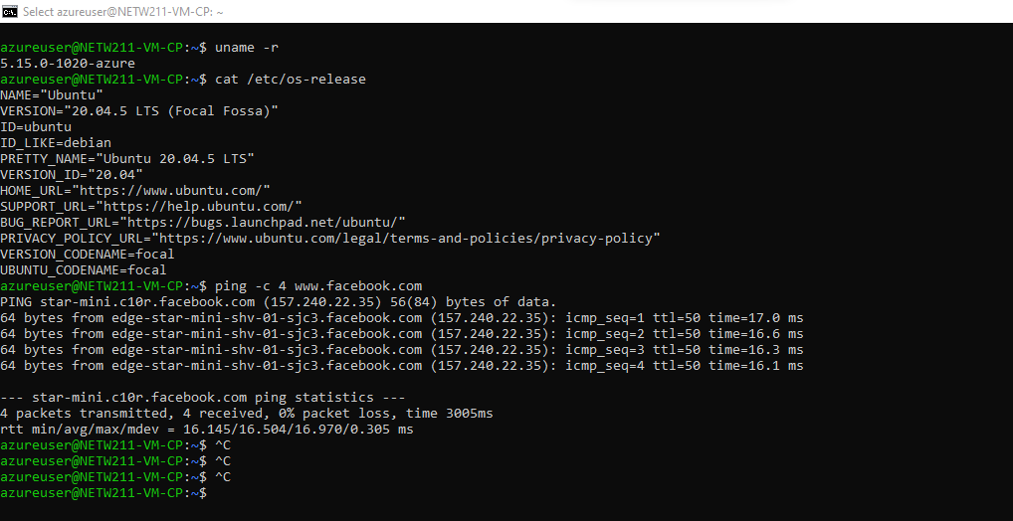
Connecting to the VM
via SSH
This screenshot should show the azureuser@NETW211-VM-Your Initials window showing the IPv4 address of the VM in the Azure cloud.

Slide 17
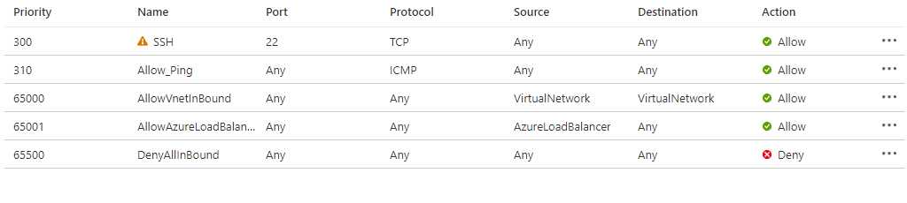
Configuring an NSG
This screenshot should show the Inbound port rules section with the newly added Allow_Ping rule.

Slide 18
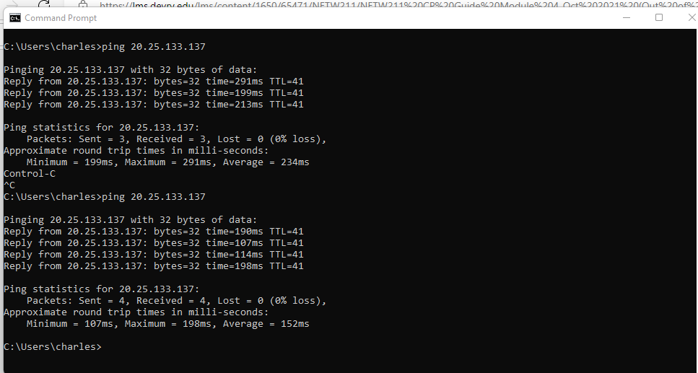
Configuring an NSG
cont’d
This screenshot should show the successful ping result from your local computer to the VM in the Azure cloud.

Slide 19
NETW211 Course Project Module 5 Cloud Storage

Slide 20
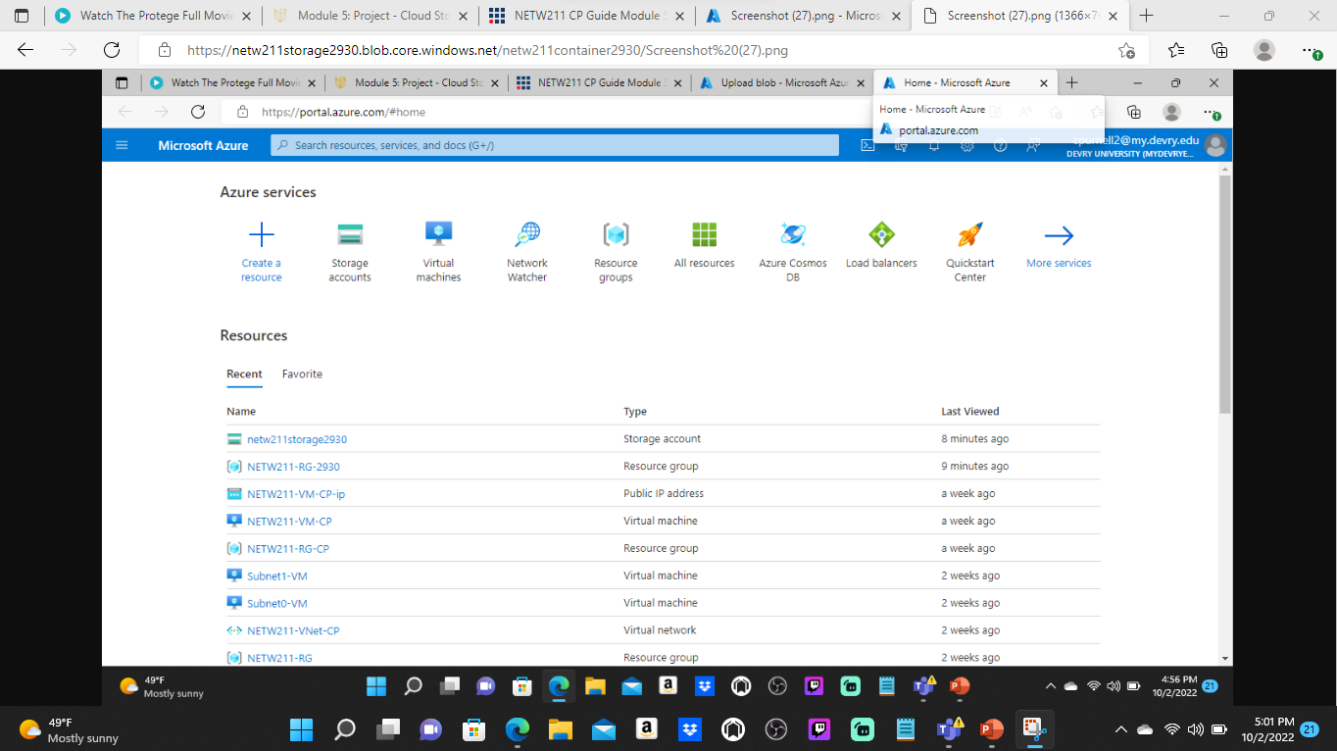
Uploading and Accessing a File
This screenshot should show the browser window with the image uploaded from your local computer and the URL on top of the window.

Slide 21
Question
What does the access tier setting do? What are the Azure blob storage access tiers?
[hint: in the Azure portal, on the Upload blob page, under Advanced, click the ? circle above the Access tier box.]
Answer here:
Indicates the online tier in which a new blob is created.
Online access tiers When your data is stored in an online access tier.
Blob lifecycle management.
References (here are two examples to get your research started):
1. Hot, Cool, and Archive access tiers for blob data, https://docs.microsoft.com/en-us/azure/storage/blobs/access-tiers-overview
2. Azure Blob Storage Access Tiers, https://devry.percipio.com/courses/c7ef0333-8560-403f-a004-9c5c843866b0/videos/2658bbe6-ee97-438b-a376-fbb079c3b3a0
3.
4.

Slide 22
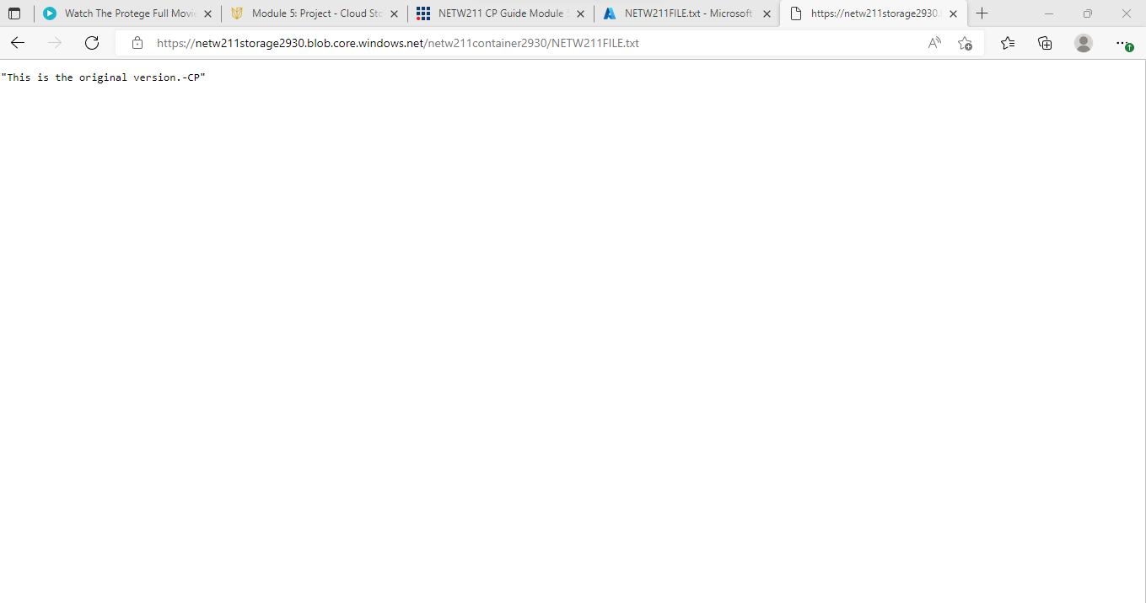
Creating Blob Snapshots
This screenshot should show the browser window with the “This is the original version. –Your Initials” message and the URL on top of the window

Slide 23
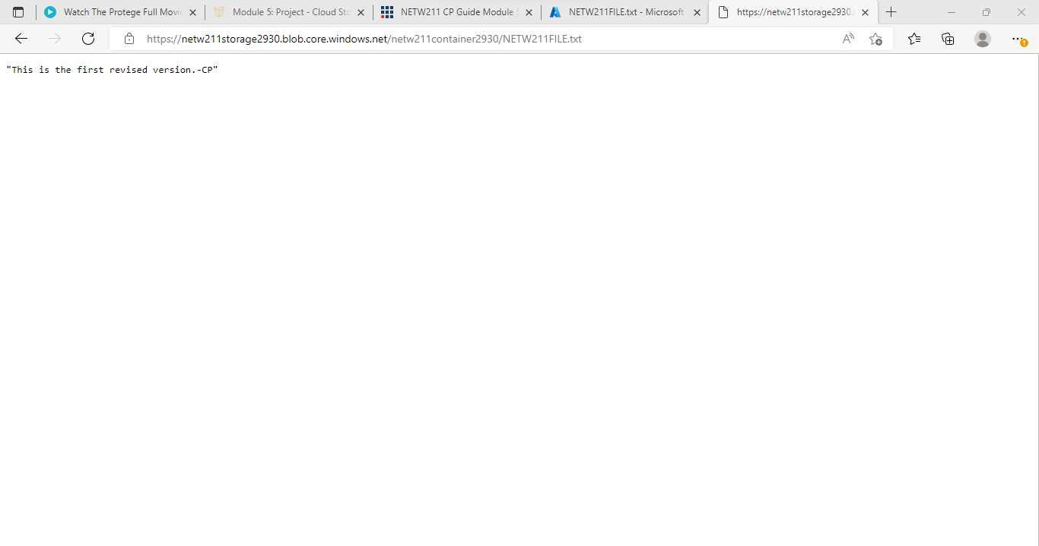
Enabling Blob Versioning
This screenshot should show the browser window with the “This is the first revised version. –Your Initials” message and the URL on top of the window.

Slide 24
NETW211 Course Project Module 6 Cloud Monitoring

Slide 25
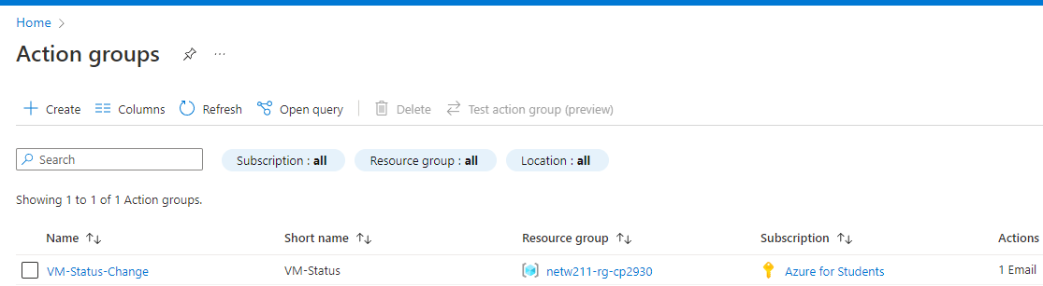
Setting up an Action Group and Notifications
This screenshot should show the “VM-Status-Change” action group on the Manage actions page.

Slide 26
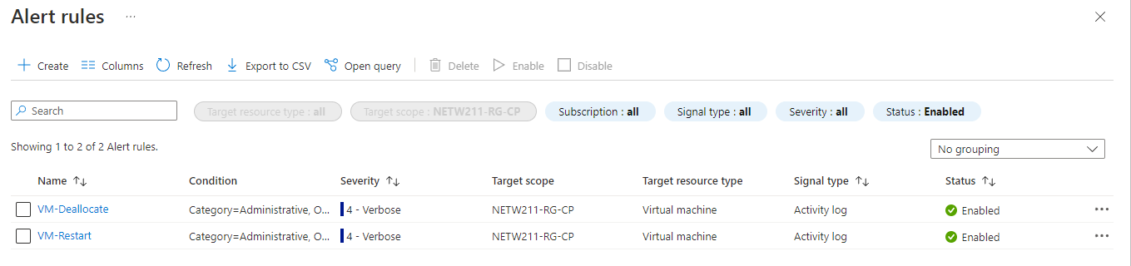
Setting up Alert Rules
This screenshot should show the Alert rules window showing the VM-Deallocate and VM-Restart rules.

Slide 27
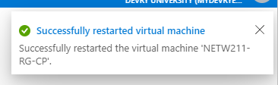
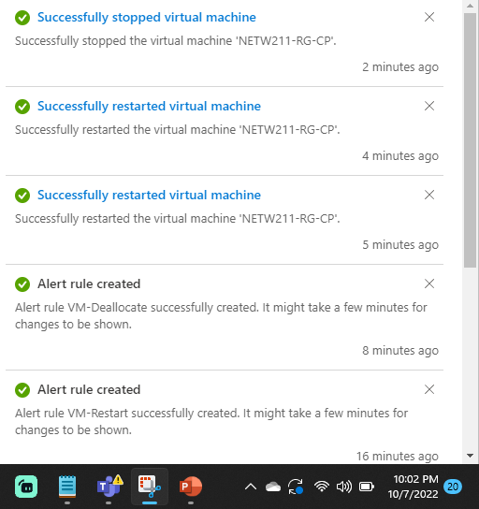
Testing Alerts
This screenshot should show the ‘VM-Restart’ was activated email message with the date and time of the alert.

Slide 28

Testing Alerts cont’d
This screenshot should show the ‘VM-Deallocate’ was activated email message with the date and time of the alert.

Slide 29
CHALLENGES
THE BIGGEST CHALLENGES IS MAKING SURE YOU PUT ALL THE INFORMATION IN CORRECTLY WHEN CREATING A VIRTUAL MACHINE BECAUSE A MINIMAL CHANGE WILL HAVE ANOTEHR RESULT AND SOMETIMES YOU’LL HAVE TO START OVER. (PAY ATTENTION TO DETAIL)

Slide 30
CAREER SKILLS I HAVE OBTAINED
Configuring identity and access management
Defining security policy
Implementing network security
Analyzing logs and managing incident response
Protecting data with Google Cloud technologies

Slide 31
C0NCLUSION
FUNDAMENTALS OF CLOUD COMPUTING HAVE TAUGHT ME DIFFERENT METHODS TO SECURE AND MONITOR MY COMPUTER. BY USING CLOUD COMPUTING IT ALLOWS YOU TO FOCUS ON OTHER TASKS WHILE STILL HANDLING SECURITY PROTOCOLS.

